Slide 1
Data Visualization in Python

Slide 2
Course Outline
Use Python modules to visualize data sets
Use Python modules to visualize linear regression

Slide 3
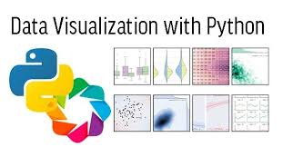
Contents
Data Visualization
Meaning
Importance
Advantages
Linear Regression
Explanation
Visualization Implementation
Linear Regression Implementation
Explanation with code
Visualization of the data.

Slide 4
Data Visualization : Introduction
In today’s era, a lot of data is being produced everyday.
Sometimes to analyze and evaluate this data for certain trends, patterns may become difficult if the data is in its raw format.
To overcome this data visualization comes into play.
Data visualization provides a good, organized pictorial representation of the data which makes it easier to understand, observe, analyze. In this unit, we will discuss how to visualize data using Python.

Slide 5
Data Visualization : Meaning
Data Visualization is a technique in which any type of data can be organized in such a way that it could generate meaningful patterns just by a glance at it.
Data Visualization helps in making the data statistics look attractive and hence help in easy evaluation and result generation out of it.

Slide 6
Data Visualization : Importance
Data Visualization make data look more understandable.
Data Visualization can help a laymen also to understand the data statistics.
Data Visualization makes it very easy to interpret data.
Data Visualization helps in easy representation of the data.

Slide 7
Data Visualization : Advantages
Data visualization is the discipline of trying to understand data by placing it in a visual context so that patterns, trends and correlations that might not otherwise be detected can be exposed.
Data visualization is advantageous when it comes to impressing clients for a deal, explaining students some kind of dataset characteristics and another such modules.

Slide 8
What is Regression?
Supervised learning algorithm.
Consists of one or more feature values and a corresponding single output value.
Output is a continuous value.
Learns the line, plane or hyperplane that best fits the training samples.

Slide 9
Linear Regression
Linear Model: assumes linear relationship between input variables (x) and a single output variable (y).
Simple Linear Regression: single input variable (x).
Multiple Linear Regression: multiple input variables (x1, x2,…,xn).

Slide 10
Linear Regression
Given an input x we would like to compute an output y
For example:
- Predict height from age
- Predict Google’s price from Yahoo’s price
- Predict distance from wall from sensors
y
x

Slide 11
Linear Regression
In linear regression we assume that y and x are related with the following equation:
y = b0+b1.x+ε
where ‘b0’ is a intercept at y-axis, ‘b1’ is slope of line, ‘ε’ represents error in measurement or other noise
What we are trying to predict
Feature values
y
x

Slide 12
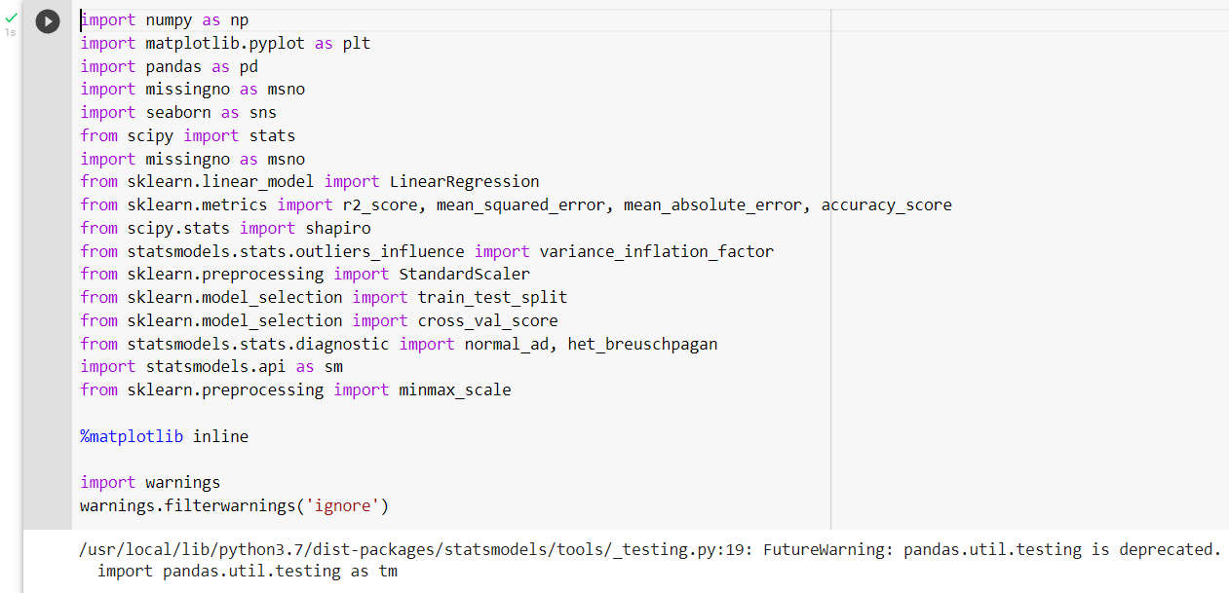
Implementation
Importing Libraries for Implementing Linear Regression with Data visualization.

Slide 13

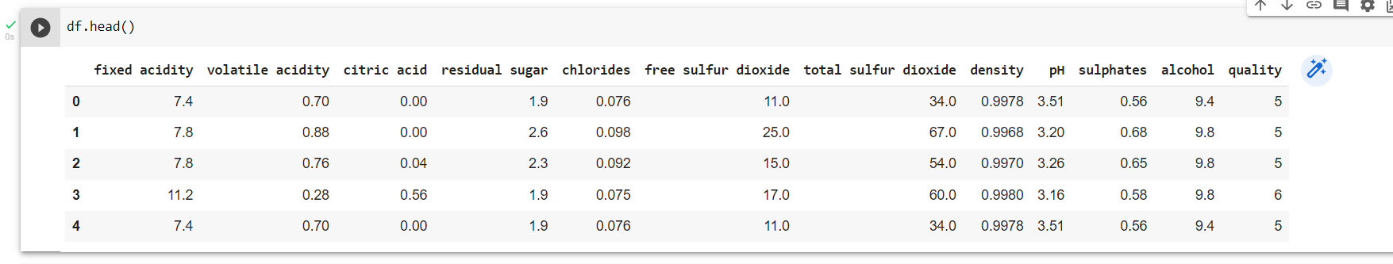
Implementation
Reading the CSV file of the dataset.
Fetching the attributes of the dataset.

Slide 14
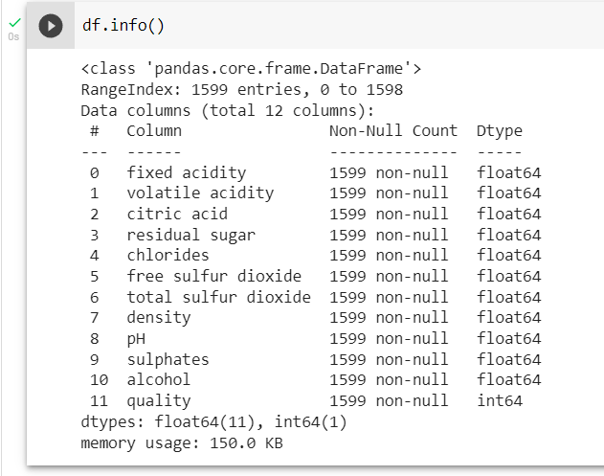
Implementation
Dataset Information.

Slide 15
Implementation
fixed acidity: most acids involved with wine or fixed or nonvolatile (do not evaporate readily)
volatile acidity: the amount of acetic acid in wine, which at too high of levels can lead to an unpleasant, vinegar taste
citric acid: found in small quantities, citric acid can add ‘freshness’ and flavor to wines
residual sugar: the amount of sugar remaining after fermentation stops, it’s rare to find wines with less than 1 gram/liter and wines with greater than 45 grams/liter are considered sweet
chlorides: the amount of salt in the wine

Slide 16
Implementation
free sulfur dioxide: the free form of SO2 exists in equilibrium between molecular SO2 (as a dissolved gas) and bisulfite ion; it prevents microbial growth and the oxidation of wine
total sulfur dioxide: amount of free and bound forms of S02; in low concentrations, SO2 is mostly undetectable in wine, but at free SO2 concentrations over 50 ppm, SO2 becomes evident in the nose and taste of wine
density: the density of water is close to that of water depending on the percent alcohol and sugar content
pH: describes how acidic or basic a wine is on a scale from 0 (very acidic) to 14 (very basic); most wines are between 3-4 on the pH scale
sulphates: a wine additive which can contribute to sulfur dioxide gas (S02) levels, wich acts as an antimicrobial and antioxidant
quality: score between 0 and 10
alcohol: the percent alcohol content of the wine - output variable

Slide 17
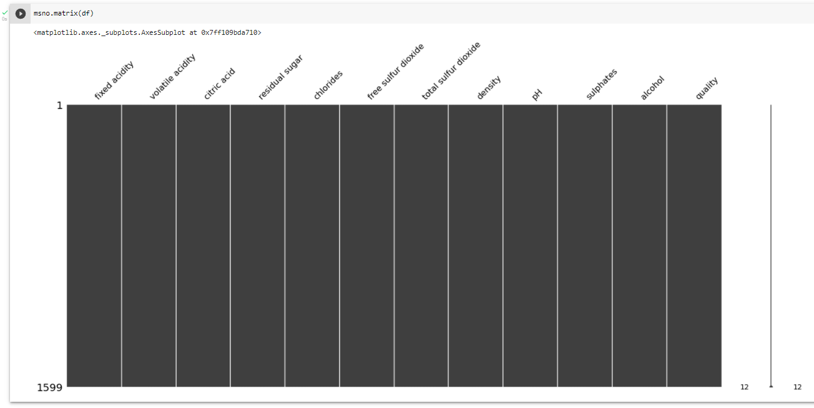
Implementation
Missing Data visualization.

Slide 18
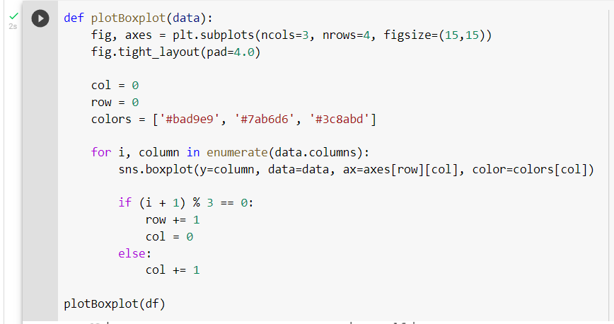
Implementation
Visualizing the data with following code.

Slide 19
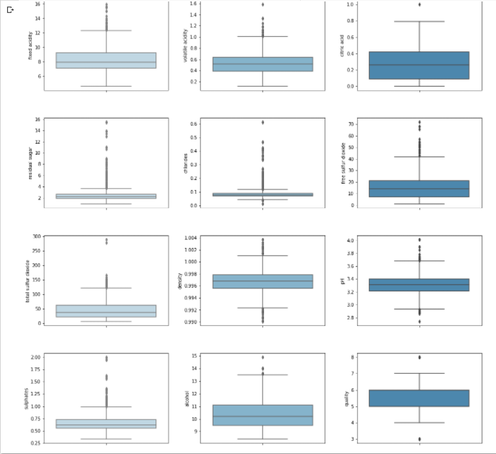
Implementation
The output.
No Multicollinearity among Independant Varaibles

Slide 20
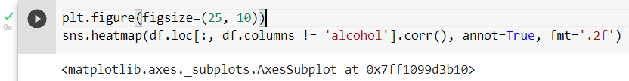
Implementation
Data Visualization code to plotting a heatmap.
Output on next slide.

Slide 21
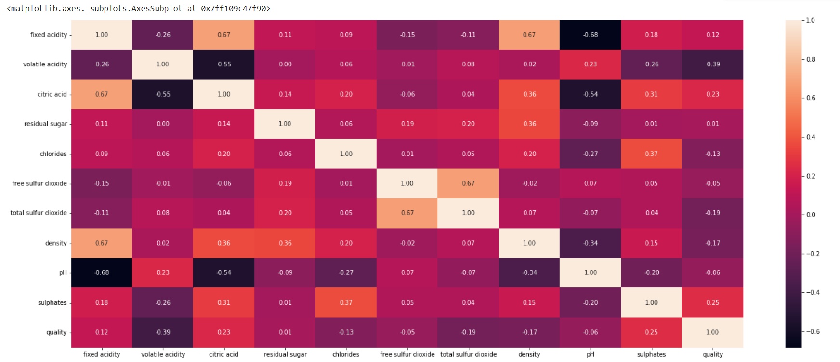
Implementation

Slide 22
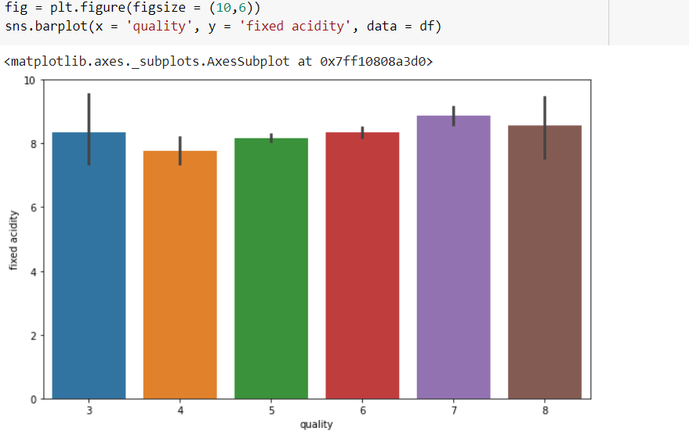
Implementation
Here we see that fixed acidity does not give any specification to classify the quality.

Slide 23
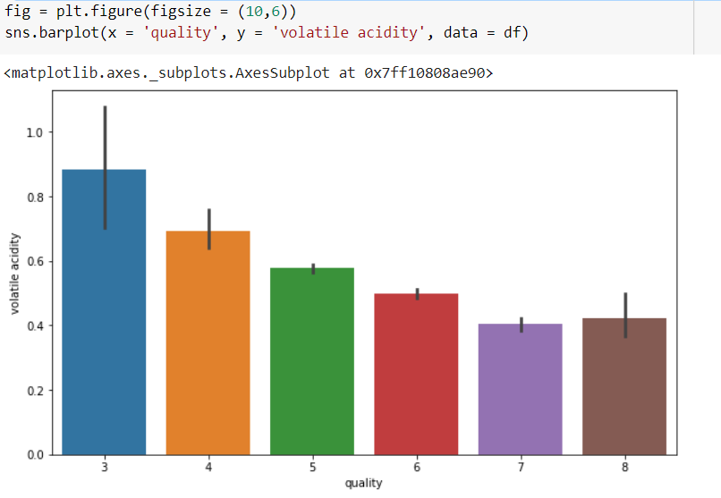
Implementation
Here we see that its quite a downing trend in the volatile acidity as we go higher the quality

Slide 24
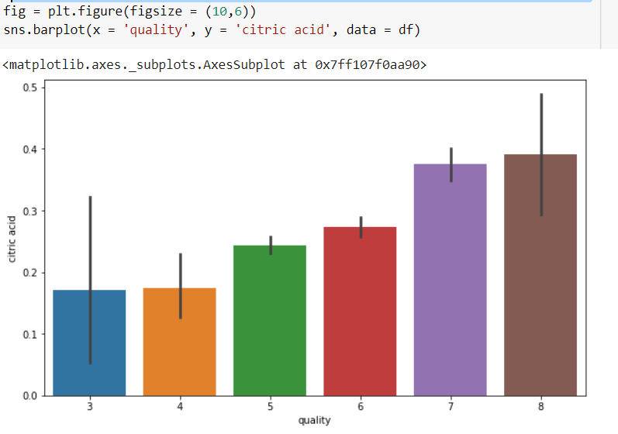
Implementation
Composition of citric acid go higher as we go higher in the quality of the wine.

Slide 25
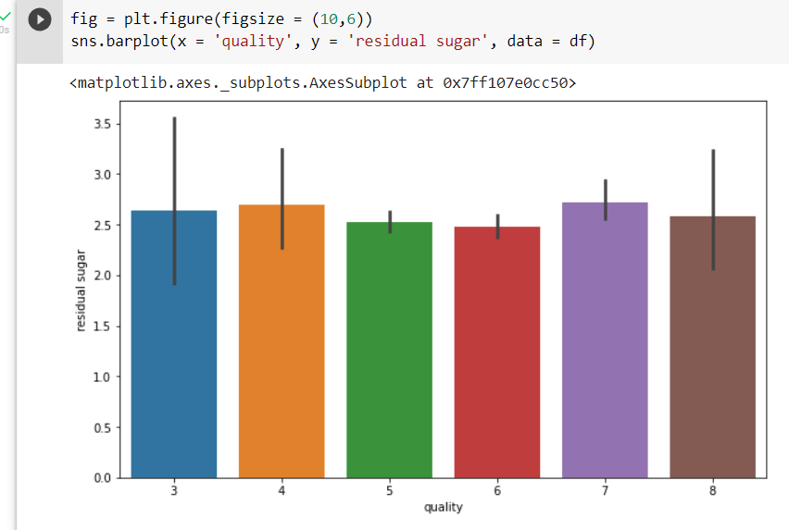
Implementation

Slide 26
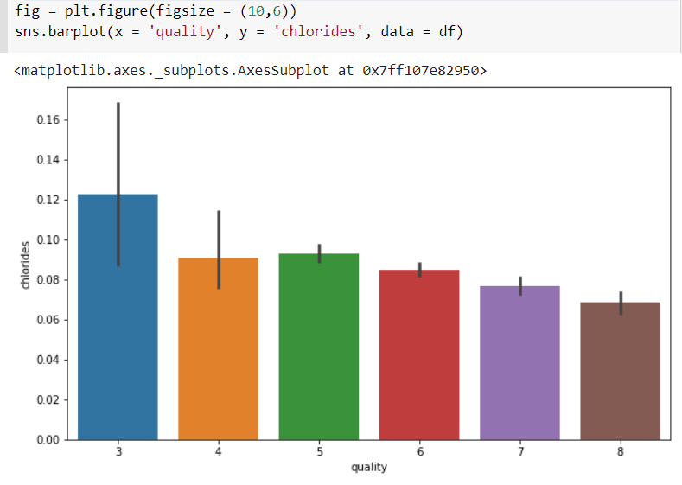
Implementation
Composition of chloride also go down as we go higher in the quality of the wine.

Slide 27
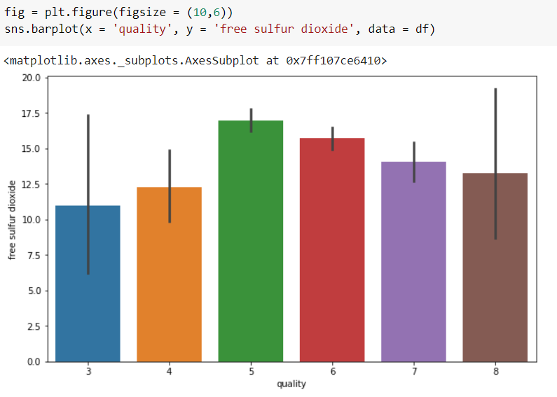
Implementation
Here we see the pattern if the free sulfur dioxide is taken into consideration.

Slide 28
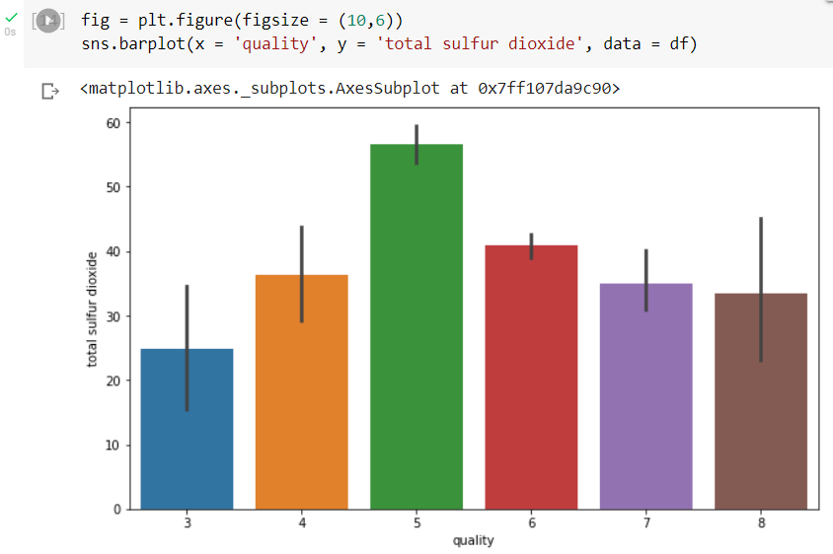
Implementation
Here we see the pattern if the total sulfur dioxide is taken into consideration.

Slide 29
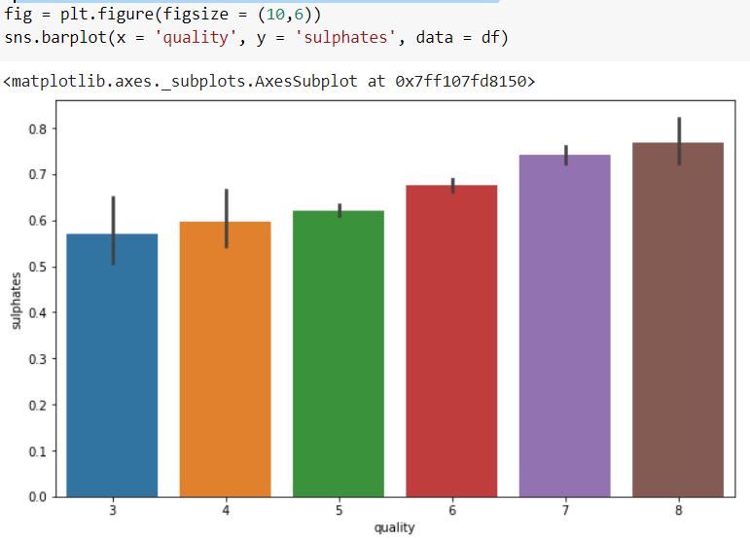
Implementation
Sulphates level goes higher with the quality of wine

Slide 30
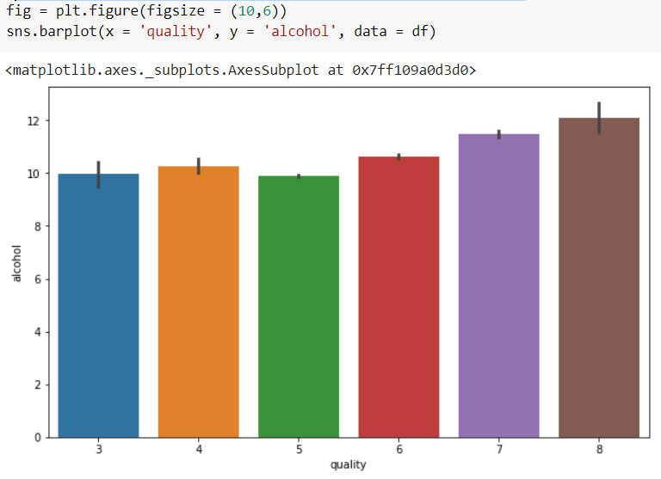
Implementation
Alcohol level also goes higher as the quality of wine increases

Slide 31
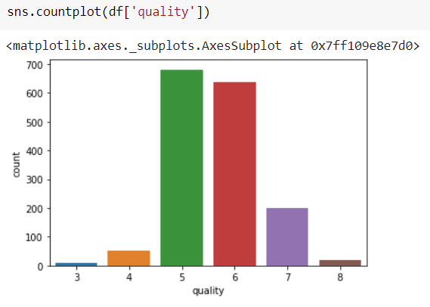
Implementation
Here we plot in regards to the quality.

Slide 32
Implementation
Features & Labels
Create tmp train/test split for assumptions test
X = df.drop(['alcohol'], axis=1)
y = df['alcohol']

Slide 33
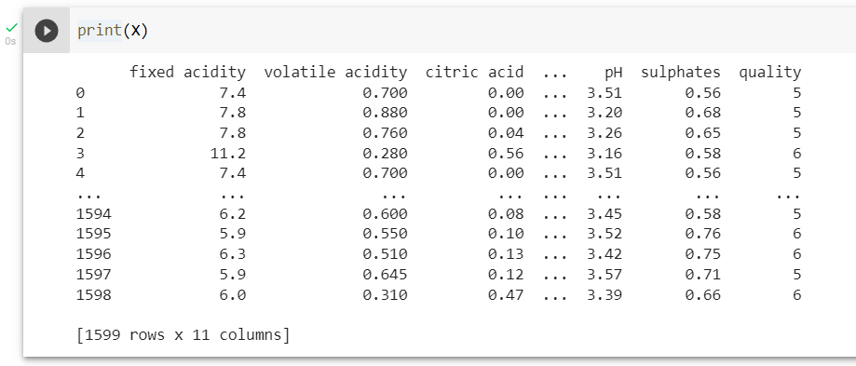
Implementation
Printing X

Slide 34
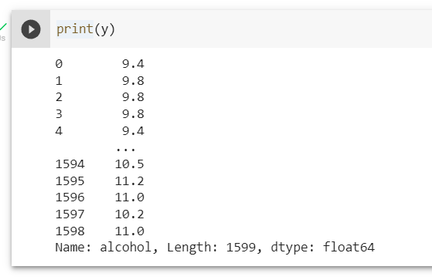
Implementation
Printing Y

Slide 35
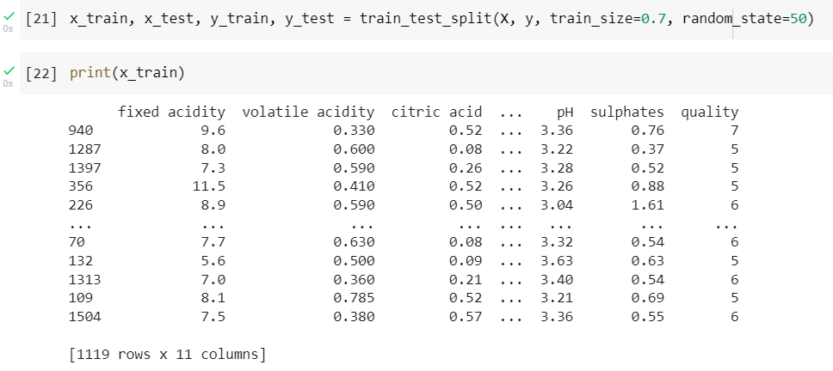
Implementation
Splitting the Dataset and & printing X training set

Slide 36
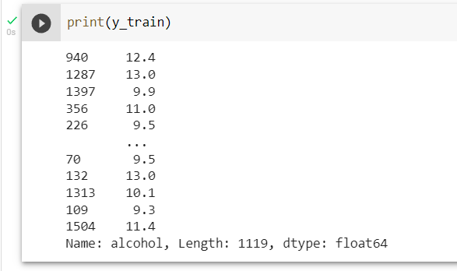
Implementation
Printing Y training set

Slide 37
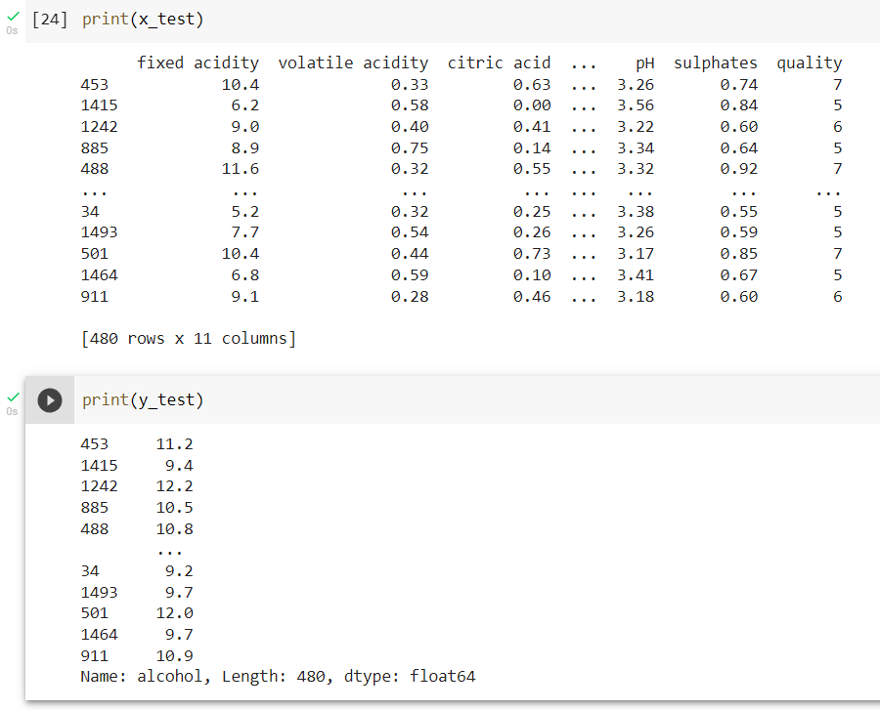
Implementation
Printing testing set.

Slide 38
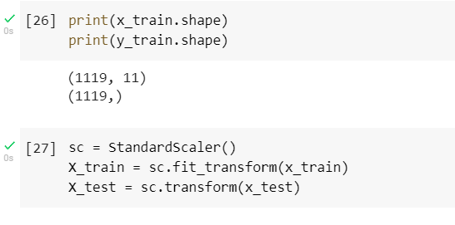
Implementation
Shaping the data.

Slide 39
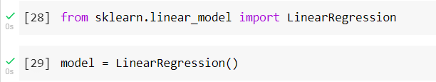
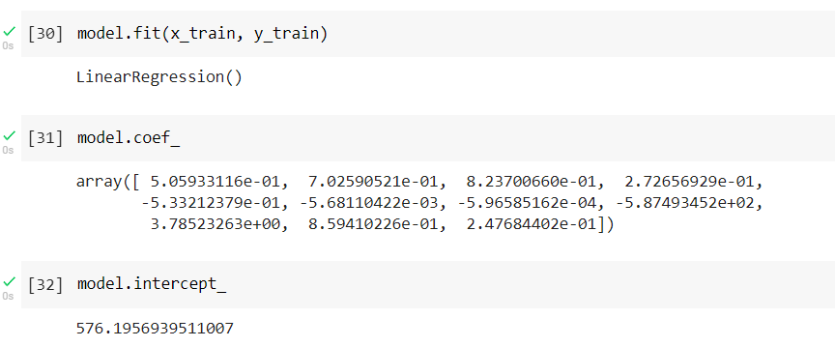
Implementation
Setting up the model
Training the model.

Slide 40

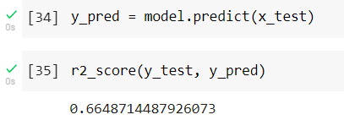
Implementation
Evaluating the model
Predicting on Test data

Slide 41
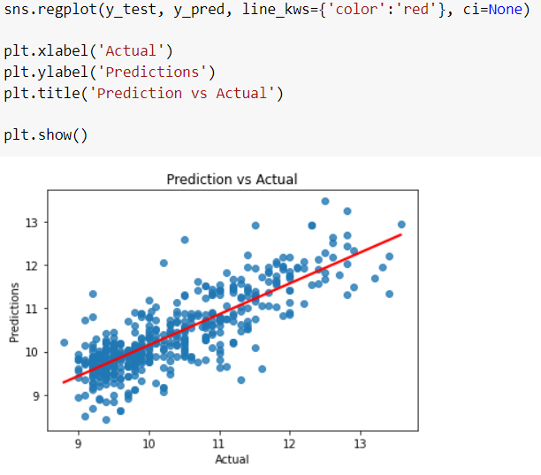
Implementation
Visualization
plot the actual vs predicted values using following code.
The figure is the Final Linear Regression Visualization Output.

Slide 42
Important Links
Dataset
https://www.kaggle.com/vishalyo990/prediction-of-quality-of-wine/data#
Implementation
https://colab.research.google.com/drive/1VTJ7U5X0NWchfCzpiK3dA2U0iN5w3cXs#scrollTo=upk6-NlrEmTG

Slide 43
References
https://learningwithdata.com/posts/tylerfolkman/the-ultimate-guide-to-linear-regression/
https://www.analyticsvidhya.com/blog/2021/05/all-you-need-to-know-about-your-first-machine-learning-model-linear-regression/
https://towardsdatascience.com/the-complete-guide-to-linear-regression-in-python-3d3f8f06bf8
https://www.keboola.com/blog/linear-regression-machine-learning
https://rstudio-pubs-static.s3.amazonaws.com/57835_c4ace81da9dc45438ad0c286bcbb4224.html
https://www.itl.nist.gov/div898/handbook/prc/section1/prc16.htm
https://www.kaggle.com/nareshbhat/outlier-the-silent-killer
https://towardsdatascience.com/ways-to-detect-and-remove-the-outliers-404d16608dba
https://community.gooddata.com/metrics-and-maql-kb-articles-43/normality-testing-skewness-and-kurtosis-241
https://towardsdatascience.com/methods-for-normality-test-with-application-in-python-bb91b49ed0f5
https://medium.com/@TheDataGyan/day-8-data-transformation-skewness-normalization-and-much-more-4c144d370e55
https://machinelearningmastery.com/standardscaler-and-minmaxscaler-transforms-in-python/
https://medium.com/@TheDataGyan/day-8-data-transformation-skewness-normalization-and-much-more-4c144d370e55
https://jyotiyadav99111.medium.com/statistics-how-should-i-interpret-results-of-ols-3bde1ebeec01

